Slide 1
Resetting the bar: Statistical significance in whole-genome
sequencing-based association studies of global populations
Sara L. Pulit, Sera A. J. de With Paul I. W. de Bakker

Slide 2
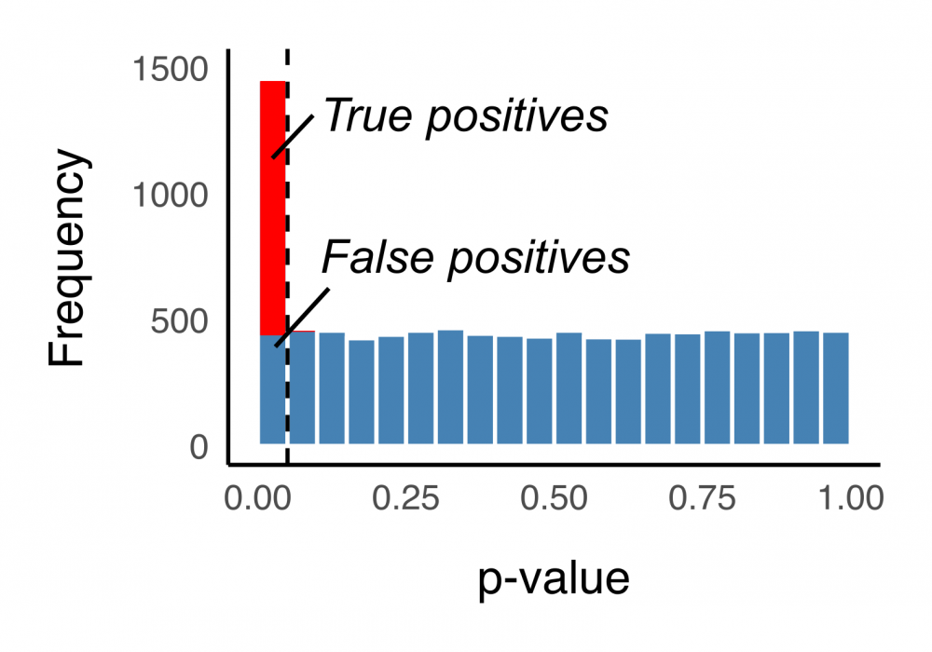
Methods
Data Sources
Genome of the Netherlands Project
1000 Genomes Project
HAPGEN Simulation
Creates new genetic data by scrambling real data
‘Cases’ to find ‘true association’
Controls as ‘null simulation’
PCA Analysis
Reduce the dimensionality of the data
Notes:
They simulate the data so that they can create perfect conditions for a model with very little variation. In any dataset there is a whole plethora of reasons for why you might see variation.
They took 268 users from each group and random.
The simulated process generated phenotypes by splitting the simulated genomes into cases and controls. The controls were null, meaning there was no association between any variant and the disease.
PCA is meant to reduce the dimensionality of the data, so that the simulated data most closely resembles the actual data. The idea is that if we know how to identify a false positive with our simulated data, then we can use those exact same methodologies applied to the thing to get the best thing
They believe that different groups have different p-value thresholds.
PCA creates a space where each real sample was positioned based on its genetic makeup.
They take the simulated genotypes and put them in the same PCA space as the real samples

Slide 3
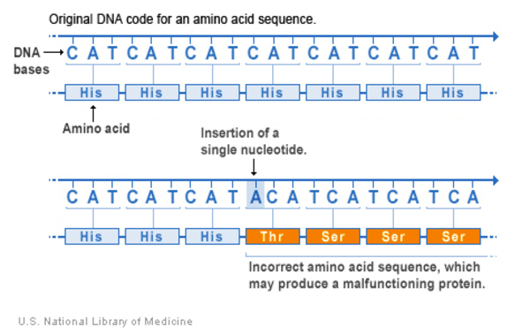
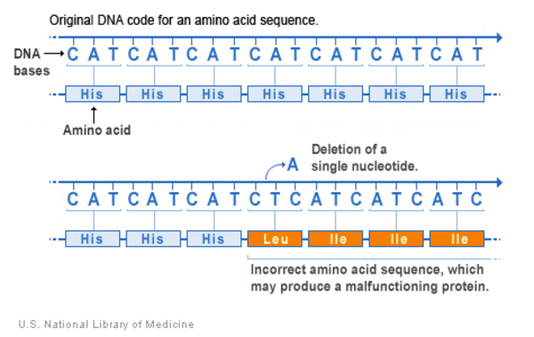
Insertion = Adding
Deletion = Removing
Source: U.S. National Library of Medicine
Notes:
A type I error, also known as a false positive, occurs when a researcher rejects the null hypothesis when it is actually true

Slide 4
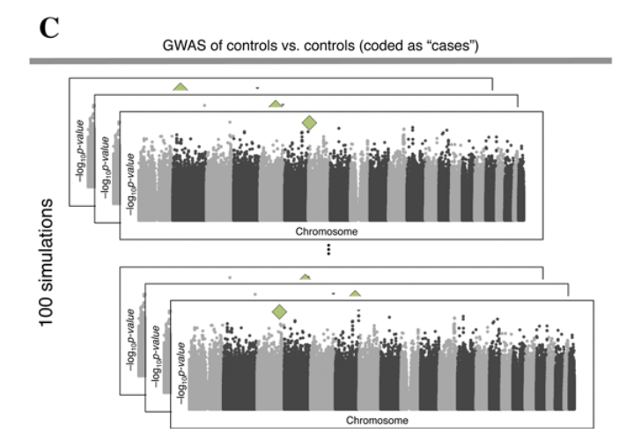

Slide 5
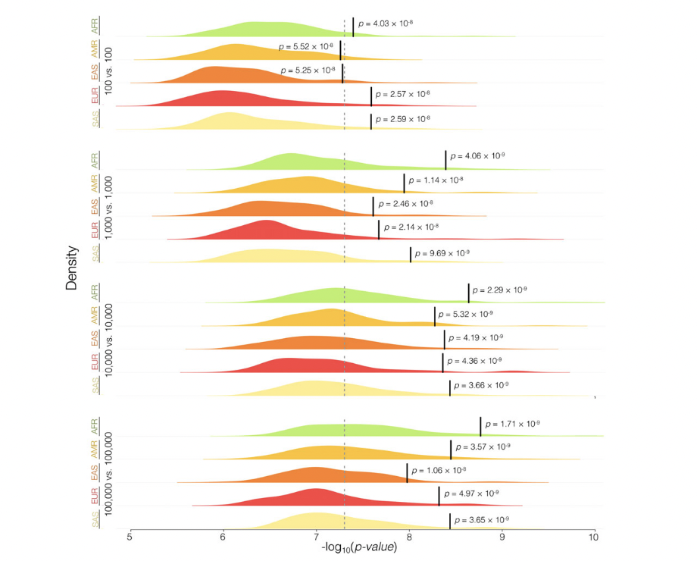
Notes:
Figure 4 shows the genome-wide significance thresholds across five global populations in various simulated rare variant association study settings. The figure shows how the significance threshold changes based on sample size and ancestry.

